Slide 1
Analysis of U.S.
Visa Decisions
Kiana Alikhademi, Mahdi Kouretchian, Diandra Prioleau

Slide 2
Introduction
Motivation
Determine whether machine learning techniques could accurately predict visa decisions
Whether biases exists in the process of visa decisions
Research Questions
Using different set of variables in the data set, how well can a classification model predict a visa decision (case status)?
Are clustering techniques able to group applicants based on case status (denied, certified, certified-expired, withdrawn) in a meaningful way?

Slide 3
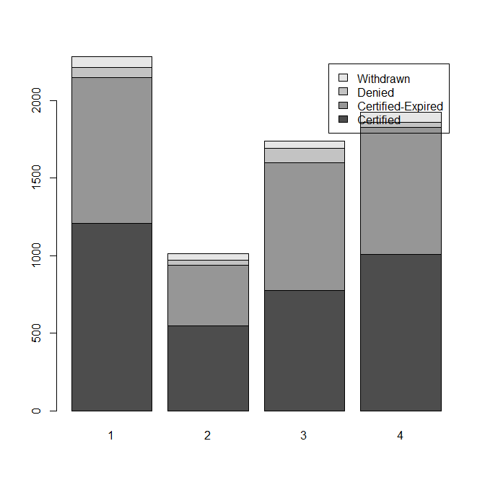
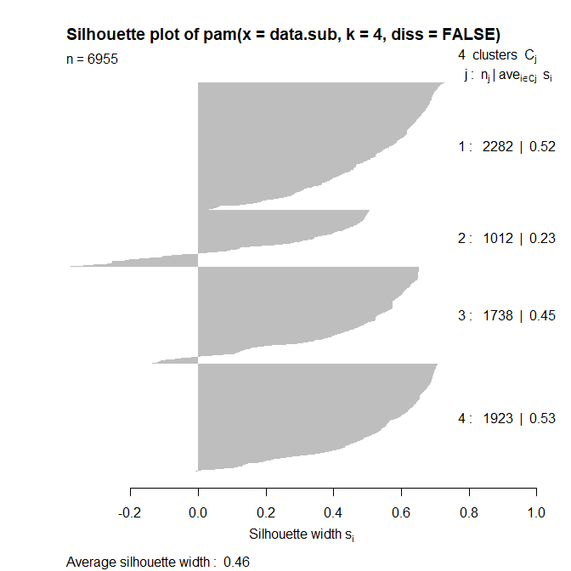
Results
 | Classification Accuracy
Decision Tree | 79.32%
Random Forest | 82.50%
Naive Bayes | 59.41%

Slide 4
Limitations
Missing values in the dataset
Variables with the majority of the values missing => discarded
Inconsistency in values
e.g. wage_offer_from_9089
Mapping of variables
Lost of information (e.g. applicant’s major)
Imbalanced of predictor variable case status
51.37% - Certified; 42.36% - Certified-Expired; 3.23% - Withdrawn; 3.04% - Denied

Slide 5
Conclusion
U.S. visa decisions can be predicted using machine learning classification models
Although RF achieved accuracy of 82%, ML techniques may not be viable option for predict visa decisions, which affect livelihood of people, since it does not achieve near perfect accuracy
Individuals in computer science, mathematics,and engineering majors likely to have application certified
Although small, individuals in education major were more likely to be denied than certified

